Slide 1
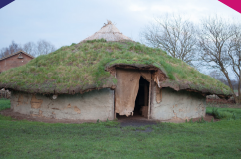
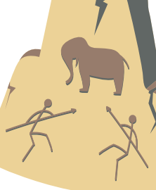
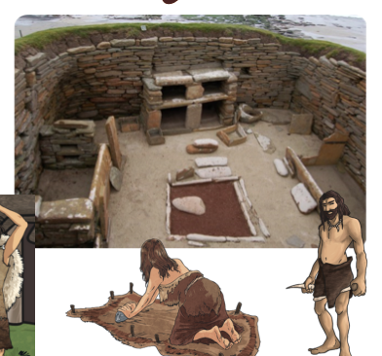
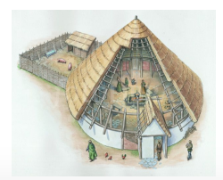
History Cycle A Spring Term 1 Y5/6
Topic: How did some aspects of life change between the Stone Age and Iron Age in Britain?
Career links
Historian
Archaeologist
Prior Learning
In Year 1/2, pupils learned - During the reign of Queen Victoria, Britain underwent great industrial expansion.
In Year 3/4 pupils learned - The Romans invaded Britain and the changes that happened as a result, including better roads, developed civilisations and defence against attack.
Did you know …
Both archaeologists and historians use sources and evidence to learn about the past. Historians study and write about history while archaeologists excavate and analyse old artefacts.
New Knowledge
Humans were around in the last Ice Age and made good use of the extra land to migrate to different places in the world. These humans - who survived the Ice Age and are our ancestors – were called Homo sapiens. The Stone Age followed the Ice Age.
The chronological order is Stone Age – Bronze Age – Iron Age.
Stone Age Britain is the oldest period in when early humans, known as cavemen, started using stones for their tools and weapons. Bronze Age Britain was a period of time 4000 years ago where people started using bronze instead of stone tools. This is an alloy made from copper and tin.
The period after the Iron Age is the Bronze Age, which was about 3000 years ago when iron became the metal used for tools. Iron was heated up and hammered into shape when hot.
Celts were tribes who lived in Britain and came originally from Ireland and Western Europe.
New Vocabulary
nomadic | A person/people who move from place to place rather than living in one place.
innovation | A better solution to a situation or environment.
hunter-gatherer | A person who looks for food and gathers it together in one place.
hillforts | Settlements built on hills to provide more protection.
roundhouse | A circular building with a thatched roof and a fire in the centre.
migration | Movement from one place to another in order to settle there.
excavate | to dig in the ground to look for old items that have been buried for a long time.
flint | a type of stone that was used in the Stone Age weaponry due to it being easy to find and shape into arrowheads.
23,000BCE
Last human ice age

