Slide 1
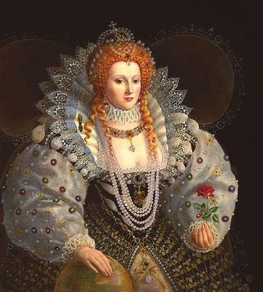
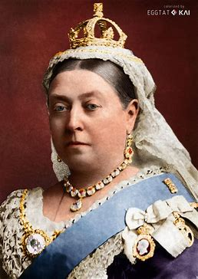
History Cycle A Spring Term 1 Y1/2
Topic: What was similar and different about Queen Elizabeth I and Queen Victoria?
Career links
History teacher Academic Librarian
Prior Learning
In Year EYFS, pupils learned that the country used to be ruled by a queen but we now have a king – King Charles. That England has a Royal family that live in London.
Did you know …
We are living in a period called the Carolean Era now that King Charles is on the throne?
New Knowledge
Queen Elizabeth I was born in 1533 and became Queen at 25 and reigned from 1558 - 1603 (44 years)-
Queen Victoria was born in 1819 and became Queen at 18 and reigned from 1837 - 1901 (64 years)
Queen Elizabeth I reigned at the end of the Tudor era.
Queen Victoria reigned during the Victorian era. ▪ Both queens reigned Britain for a long time and made a big impact on British life.
Queen Elizabeth was a good public speaker, spoke 6 different languages and loved musical theatre.
Queen Victoria made a law to make all children go to school, became queen of the largest empire in history and is the longest reigning monarch in British history.
Both Queens held similar values such as justice, fairness, love, sacrifice, loyalty, power, peace and happiness.

Slide 2
Year 1000 BCE
Present Day 2025
1820 CE
Florence Nightingale born
1806 CE
Ralph Ward Jackson was born
1666 CE
Great Fire of London
1825 CE
Steam Train introduced to Britain
1887 CE
L. S. Lowry born
1805 CE
Mary Seacole born
1533 CE
Queen Elizabeth 1st was born
1819 CE Queen Victoria was born
1901CE
Queen Elizabeth died
1838 CE
Queen Victoria became Queen
1558 CE
Queen Elizabeth 1st became Queen
1603CE
Queen Elizabeth died

