Slide 1
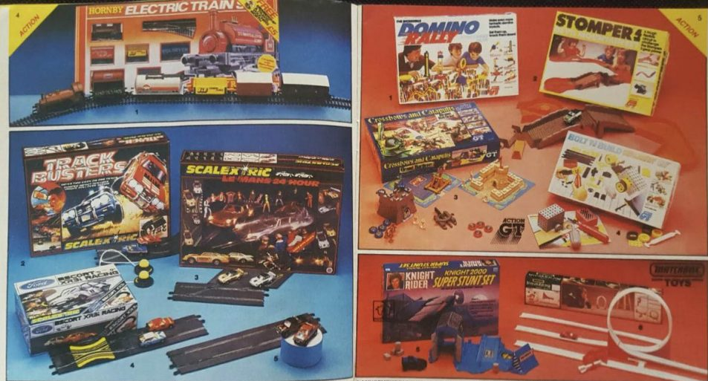
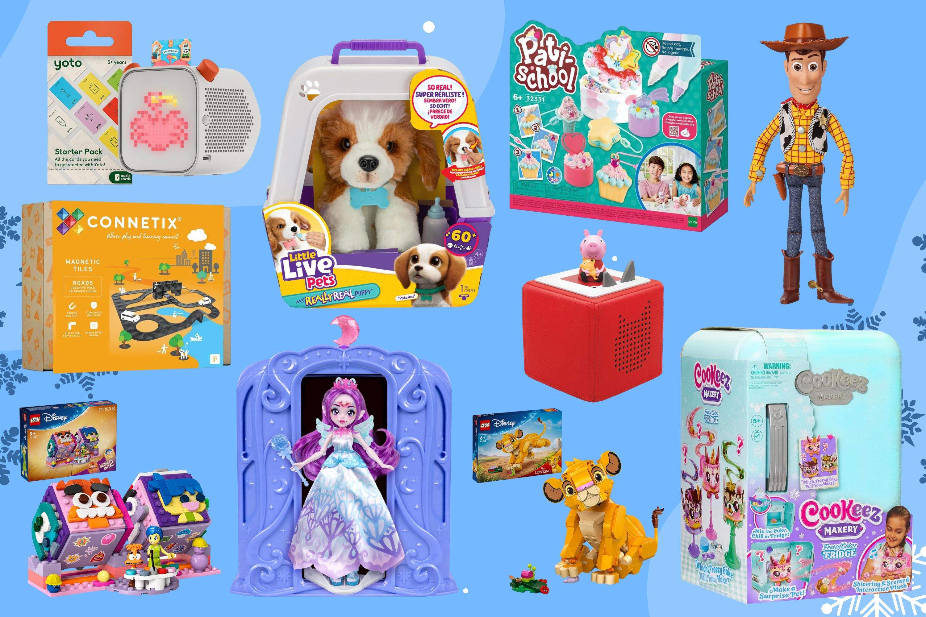
History Cycle A Spring Term 1 EYFS
Topic: What are the similarities and differences between toys now and those my grandparents played with?
Prior Learning
Pupils have learned that children of all ages enjoy playing with toys.
Pupils know that people might receive toys as gifts for a celebration
Did you know the first toys in the world were probably sticks and rocks?
New Knowledge
Children play with toys when they are young.
Parents and grandparents played with some similar and some different types of toys when they were young.
Dolls and cars like we have were toys when our grandparents were young

Slide 2
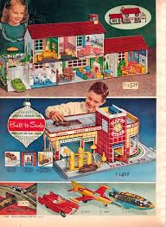
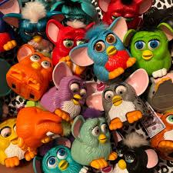
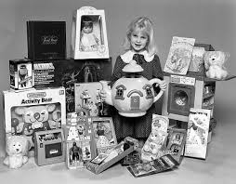
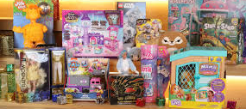
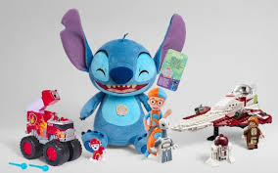
1940+ 1980+ 2021
Present Day 2025
When my Grandparents were born
When my Parents were born
When I was born

