Slide 1
French Phonics KS2
Grapheme Phoneme Correspondence with picture prompts

Slide 2
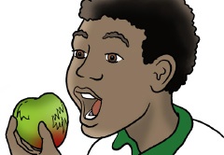
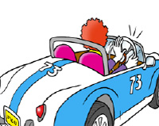
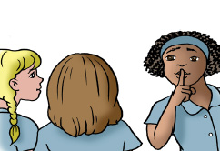
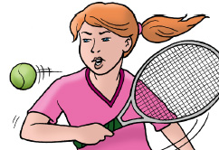
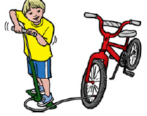
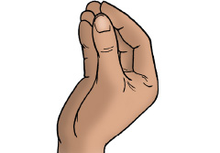
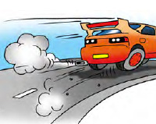
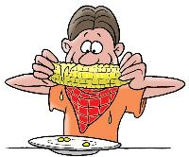

Slide 3
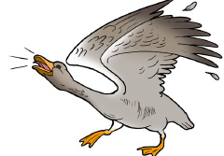
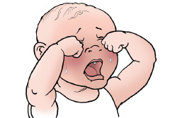
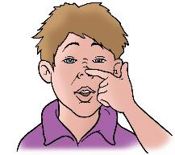
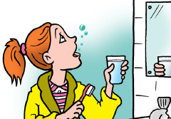
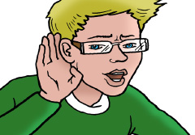
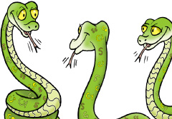

Slide 5
a

Slide 6
en em an

Slide 7
q qu c

Slide 8
ch

Slide 9
e before 1 consonant

Slide 10
e before 2 consonants è/ai e before final t

Slide 11
é er

Slide 12
eu

Slide 13
g

Slide 14
g before e j

Slide 15
gn

Slide 16
i

Slide 17
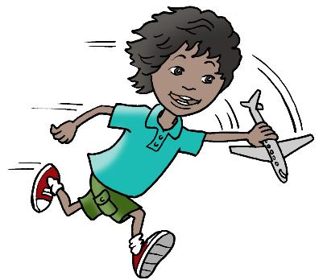
ien

Slide 18
in

Slide 19
o not at end

Slide 20
o au

Slide 21
oi

Slide 22
on

Slide 23
ou oû

Slide 24
r rr

Slide 25
s c before i

Slide 26
th

Slide 27
u

Slide 28
un um

Slide 29
ll after e

Slide 30
z

Slide 31
Slides 32 - 57
Activity 1:
Look at image, do action and make sound. Then check.
Activity 2:
Look at image and write down the grapheme you think it is.

Slide 32
a

Slide 33
en em an

Slide 34
q qu c

Slide 35
ch

Slide 36
e before 1 consonant

Slide 37
e before 2 consonants è/ai e before final t

Slide 38
é er

Slide 39
eu

Slide 40
g

Slide 41
g before e j

Slide 42
gn

Slide 43
i

Slide 44
ien

Slide 45
in

Slide 46
o not at end

Slide 47
o au

Slide 48
oi

Slide 49
on

Slide 50
ou oû

Slide 51
r rr

Slide 52
s c before i

Slide 53
th

Slide 54
u

Slide 55
un um

Slide 56
ll after e

Slide 57
z

Slide 58
Slides 59 -84
Activity:
Read the graphemes, then check you have pronounced them correctly.

Slide 59
a

Slide 60
en em an

Slide 61
q qu c

Slide 62
ch

Slide 63
e before 1 consonant

Slide 64
e before 2 consonants è/ai e before final t

Slide 65
é er

Slide 66
eu

Slide 67
g

Slide 68
g before e j

Slide 69
gn

Slide 70
i

Slide 71
ien

Slide 72
in

Slide 73
o not at end

Slide 74
o au

Slide 75
oi

Slide 76
on

Slide 77
ou oû

Slide 78
r rr

Slide 79
s c before i

Slide 80
th

Slide 81
u

Slide 82
un um

Slide 83
ll after e

Slide 84
z

